Slide 1

Problem Solving Using Computer
Course Code: BCAC 0018
Lecture - 1
Course: BCA I Year I Semester
By: Mr. Sanjiv Agrawal
Sanjiv.agrawal@gla.ac.in
+91-8923015116

Slide 2
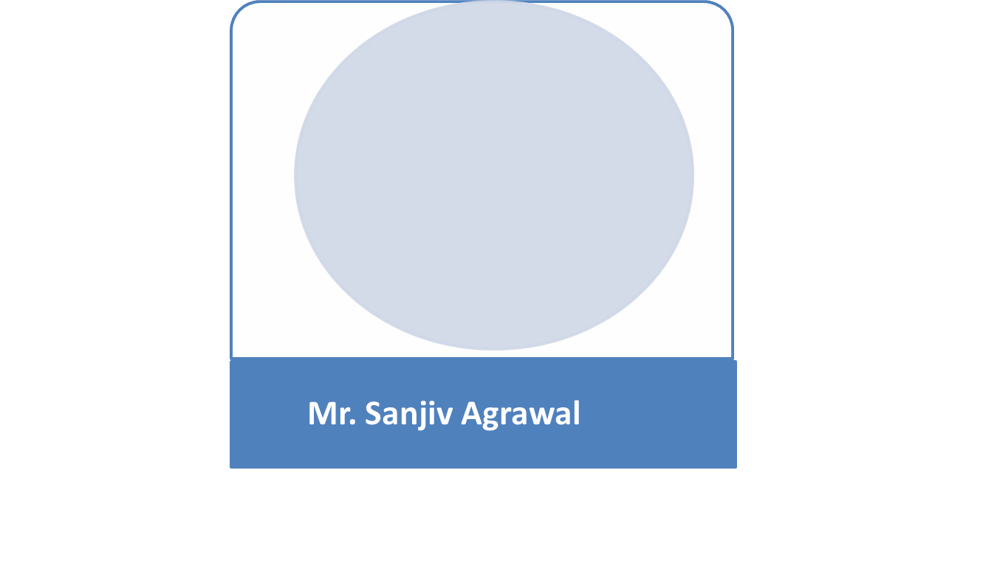
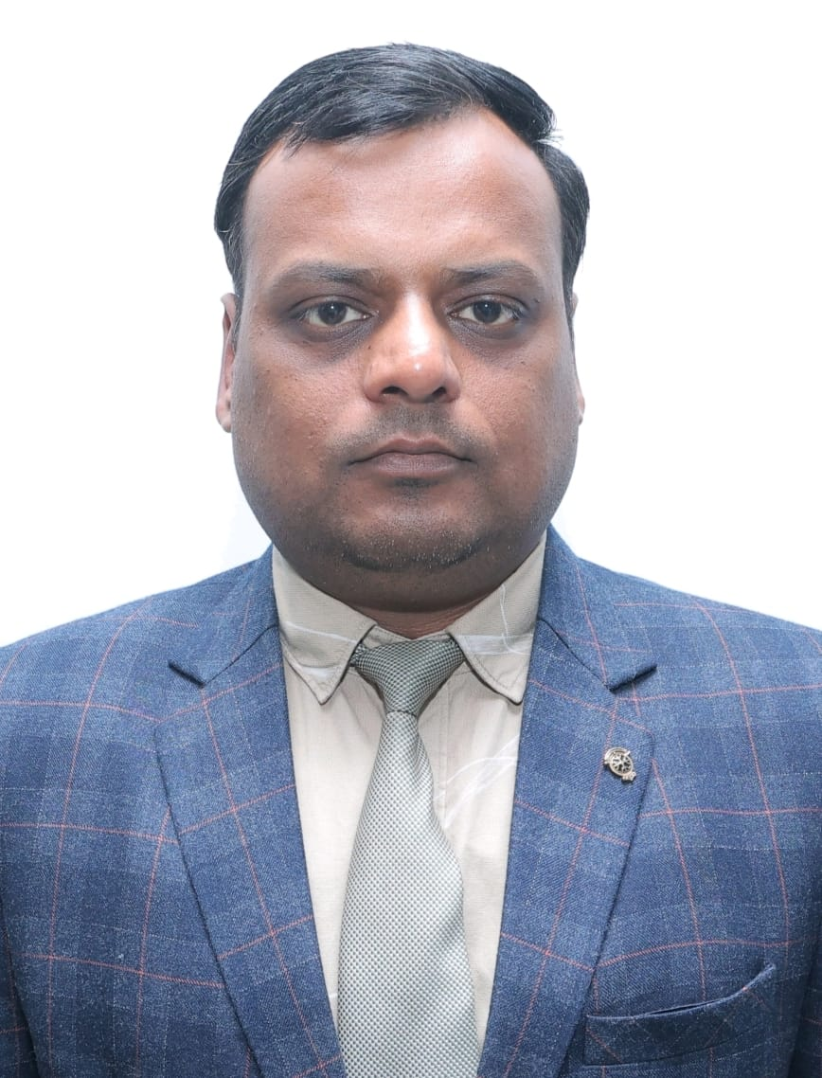
Instructors
Assistant Professor
Department of Computer Engineering & Applications,
GLA University, Mathura, U.P.

Slide 3
Syllabus
BCAC 0018: PROBLEM SOLVING USING COMPUTER
Credits: 04 L–T–P: 4–0–0
Objective: The objective of this course is that students will be able to learn basic fundamentals and concepts related to computer architecture, and this course also allows basic learning of syntax and semantics and functions in Python programming.
Module No. | Content | Teaching Hours
I | Computer Fundamentals: Introduction to Computers: Characteristics of Computers, Uses of computers, Types and generations of Computers. Basic Computer Organization - Units of a computer, CPU, ALU, memory hierarchy, registers, I/O devices. Planning the Computer Program: Concept of problem solving, Problem definition, Program design, Debugging, Types of errors in programming, Documentation. Techniques of Problem Solving: Flowcharting, decision table, algorithms, Structured programming concepts, Programming methodologies viz. top-down and bottom-up programming. Overview of Programming: Structure of a Python Program, Elements of Python, IDEs for python, Python Interpreter, Using Python as calculator, Python shell, Indentation. | 26
II | Introduction to Python: Atoms, Identifiers and keywords, Literals, Strings, Operators (Arithmetic operator, Relational operator, Logical or Boolean operator, Assignment, Operator, Ternary operator, Bit wise operator, Increment or Decrement operator). Creating Python Programs: Input and Output Statements, Control statements (Looping- while Loop, for Loop, Loop Control, Conditional Statement- if...else, Difference between break, continue and pass). Structures: Numbers, Strings, Lists, Tuples, Dictionary, Date & Time, Modules, Defining Functions, Exit function, default arguments. File handling in python. Introduction to Advanced Python: Objects and Classes, Inheritance, Regular Expressions, Event Driven Programming, GUI Programming. Basic concepts of concepts of Package and modules. | 26

Slide 4
Text Book:
Rober Sedgewick, K Wayne -Introduction to Programming in Python: An interdisciplinary Approach" Pearson India.
Reference Books:
P. K. Sinha & Priti Sinha , “Computer Fundamentals”, BPB Publications, 2007.
Dr. Anita Goel, Computer Fundamentals, Pearson Education, 2010.
T. Budd, Exploring Python, TMH, 1st Ed, 2011.
Python Tutorial/Documentation www.python.or 2010.
Allen Downey, Jeffrey Elkner, Chris Meyers , How to think like a computer scientist : learning with python , Freely available online.2012.
Suggestive digital platforms web links:
https://www.pearsoned.co.in/prc/book/anita-goel-computer-fundamentals-1e-1/9788131733097
http://docs.python.org/3/tutorial/index.html
http://interactivepython.org/courselib/static/pythonds
http://www.ibiblio.org/g2swap/byteofpython/read/

Slide 5
Outcome: A student who successfully completes the course will have the ability to:
  CO1: Understand hardware components of computer system such as memory system organization, input/output devices, aware of software components of computer system, and windows operating system concepts.
  CO2: Develops basic understanding of computers, the concept of algorithm and algorithmic thinking.
  CO3: Develops the ability to analyze a problem, develop an algorithm to solve it.
  CO4: Develops the use of the Python programming language to implement various algorithms, and develops the basic concepts and terminology of programming in general.
  CO5: Introduces the more advanced features of the Python language

